Slide 1
CMOS
CCD

Slide 2

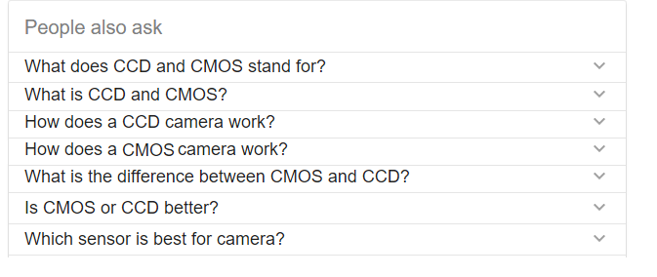
CCD vs CMOS

Slide 3
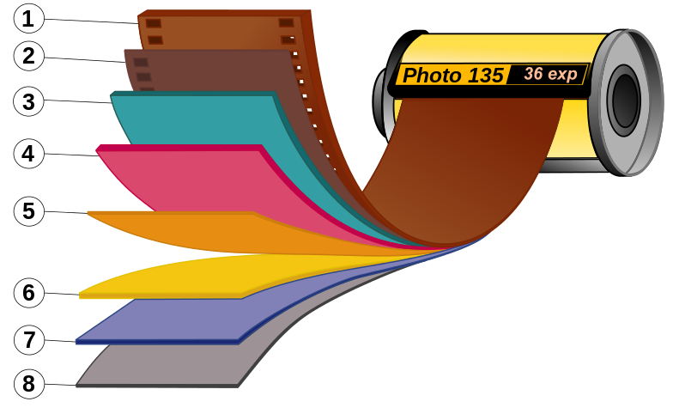
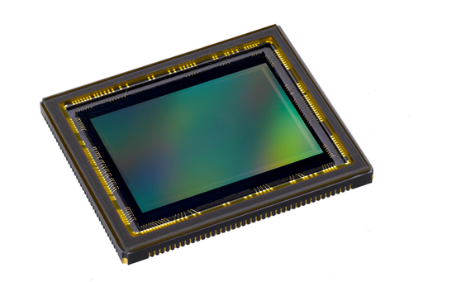
What is CCD and CMOS?
Source: Albedo Media
Source: wikipedia.org/wiki/Photographic_film
Notes:
Think of the sensor as the electronic equivalent of film. With film cameras, you could choose from hundreds of film brands, each with its own unique and identifiable characteristics. With digital cameras, much of that technology is built into the hardware, and you can apply special filmlike effects later with software.
Your camera’s sensor determines how good your images look and how large you can scale them or print them. Image quality depends not only on the size of the sensor, but also on how many millions of pixels (light-sensitive photosites) fit on it, and the size of those pixels.

Slide 4
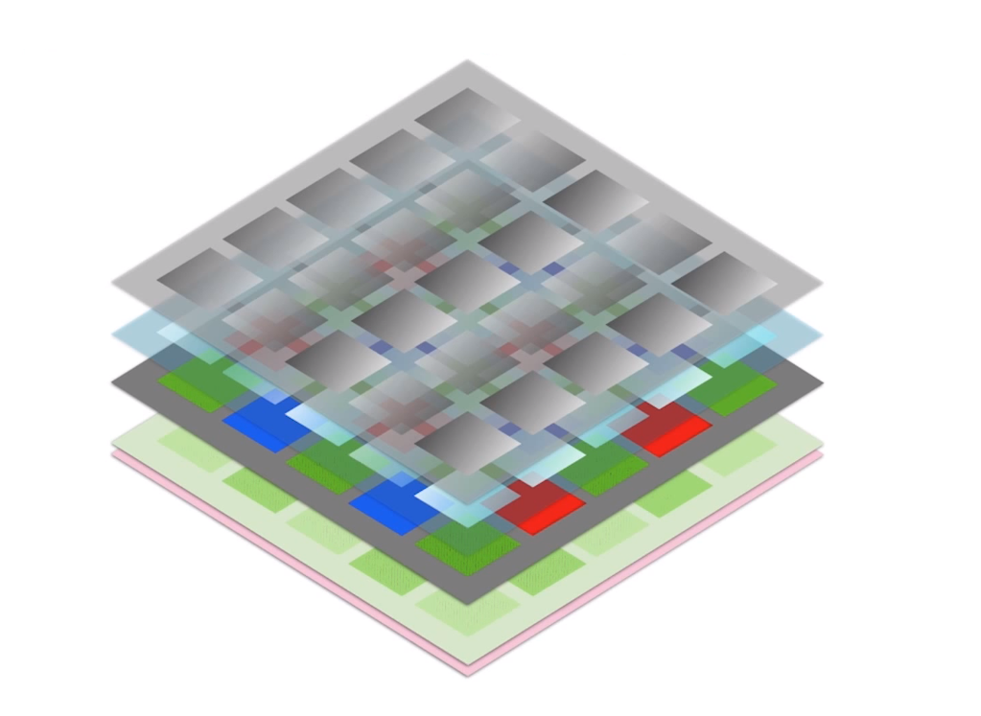
How does a CCD camera work?
MICRO LENSES
Source: Udacity (Computational Photography)

Slide 5
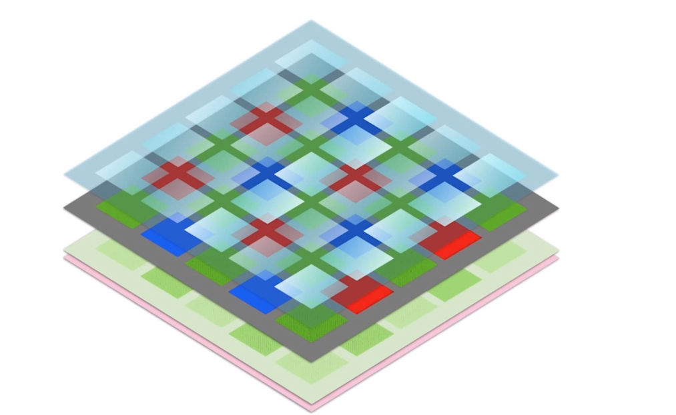
HOT MIRROR
Source: Udacity (Computational Photography)

Slide 6
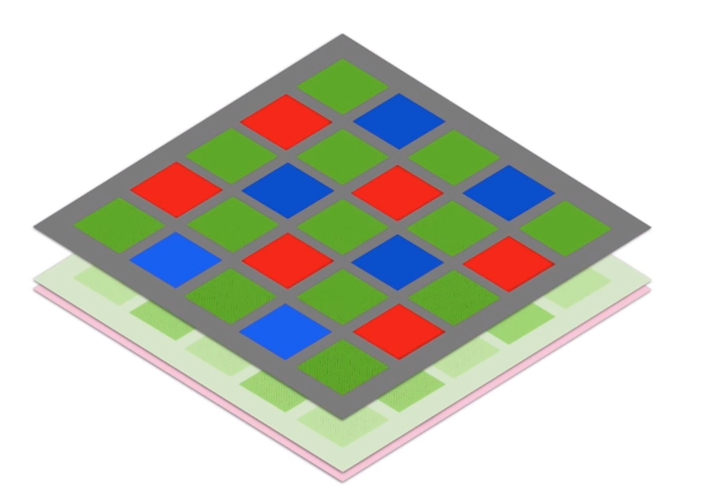
BAYER FILTER
Source: Udacity (Computational Photography)

Slide 7

PHOTODIODES
Source: Udacity (Computational Photography)
Notes:
Beneath the Bayer patterns there are the the photdiodes which can referred to as photsites, where information is captured and converted into light intensities and colours.

Slide 8
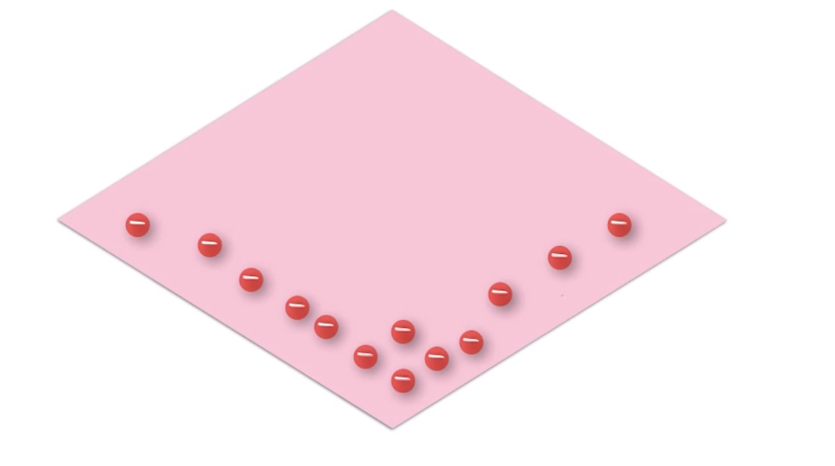
WELL (DEPLETION LAYER)
Source: Udacity (Computational Photography)

Slide 9
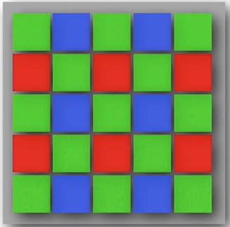


CMOS
CCD
AMPLIFIER
AMPLIFIER
AMPLIFIER
AMPLIFIER
AMPLIFIER
AMPLIFIER
AMPLIFIER
AMPLIFIER
AMPLIFIER
AMPLIFIER
AMPLIFIER
AMPLIFIER
AMPLIFIER
AMPLIFIER
AMPLIFIER
AMPLIFIER
AMPLIFIER
AMPLIFIER
AMPLIFIER
AMPLIFIER
AMPLIFIER
AMPLIFIER
AMPLIFIER
AMPLIFIER
AMPLIFIER
Notes:
El procesamiento en el CCD ocurre una vez todo ha sido almacenado (tira a tira).
Es decir los “fotositos” no llevan acabo ningún procesamiento.

Slide 10
Is CMOS or CCD better?
Energy
Light sensitivity
Processing speed
Resolution
Dynamic Range
Noise levels
Camera Size
System integration
Other things to consider

Slide 11



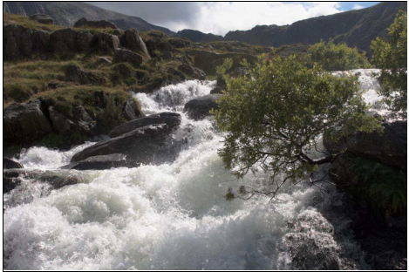
CMOS
CCD
CMOS
CCD
3.3-5 V
Energy
7-10 V
Processing speed
Camera Size
Noise/Image Quality
Dynamic Range
Source: Photografeed.com
Light Sensitivity
Source: High Dynamic Ranging (Rafał K. Mantiuk)
Notes:
Energy. CCD chips record the pixels (when light strikes) on the chip and then send these pixels one after the other. Thus, the time taken for sending the pixels for one image increases. Also, due to constant fetching and sending actions, the chip uses a lot of energy. In case of CMOS chips, the sensors themselves have a lot of inbuilt circuitry, which enables reading of the pixels at the photo sensor level itself.
There less energy is utilized due to this action and also. Esto implica por tanto mayor autonomía también.
Processing speed. there is no time lag, therefore processing speed is faster. gracias al CMOS conseguimos cámaras con una velocidad de ráfaga más alta
Camera Size. La diferencia principal es que aquí la digitalización de los píxeles se realiza internamente en unos transistores que lleva cada celda, por lo que todo el trabajo se lleva a cabo dentro del sensor y no se hace necesario un chip externo encargado de esta función. Con esto conseguimos reducir costes y equipos más pequeños
Noise/Image quality. CCD sensors have lower noise levels because its layout allows more pixels to be recorded on its surface. Dado que en el CMOS se procesa la imagen en cada celda, hay menos espacio para capturar pixels en su superficie. Hence, the colors of the images that are captured are more vibrant. This improves the image quality.
Además al realizarse el procesamiento de la imagen externamente, puede dedicarse de manera óptima a procesar.
The latest global shutter architectures from companies like CMOSIS provide read noise levels comparable to, and in some cases better than, CCD.
Dynamic Range. Dynamic range represents the camera’s ability to display/reproduce the brightest and darkest portions of the image and how many variations in between. Por este motive, mientras que hace años one might reasonably have said that CCD sensors were the better choice in low-light situations, while CMOS sensors were a nose ahead in brightly lit situations. The image quality for CMOS sensors has improved so drastically of late, however, that they are now well suited for low-light situations as well.

Slide 12
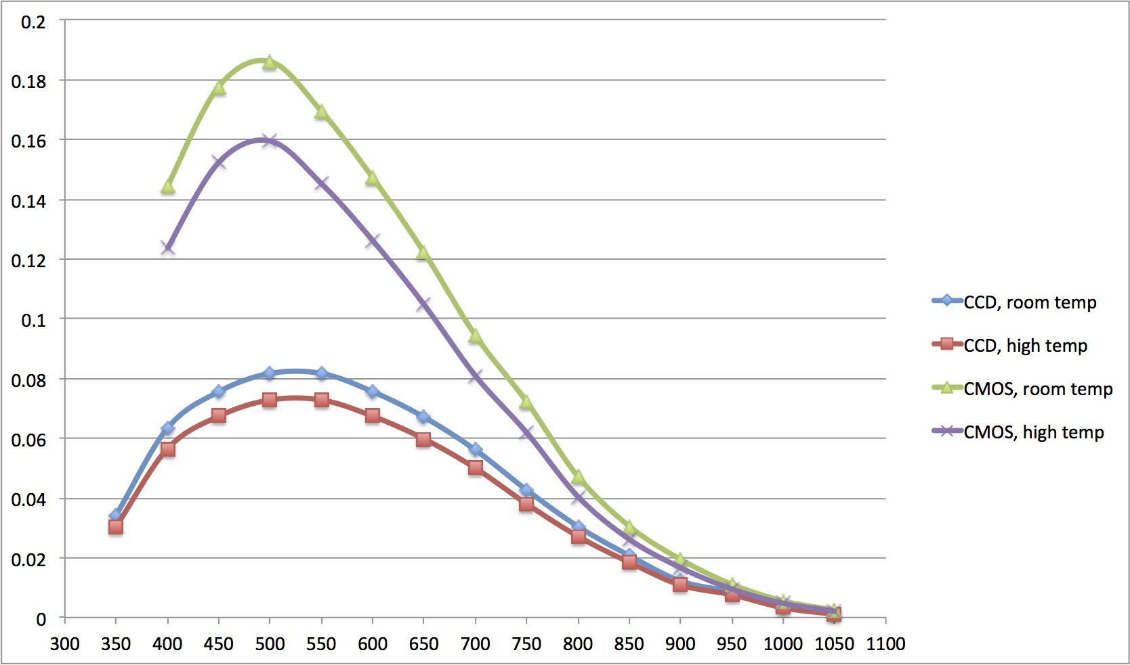
Light Sensitivity
System Integration
Price
Notes:
Light sensitivity. Light Sensitivity. CCD sensors work effectively in low light conditions. The pixels are first recorded on the chip and then they are transmitted. Hence, the image will be enhanced. In CMOS, there are a lot of sensors that are cluttered on the chip. Thus, the light sensitivity reduces as there are a number of circuits through which the light needs to penetrate. Thus, such an image can be of low quality. However, due to the presence of small circuits on the chip, the image is boosted at every stage.
QE (Quantum Efficiency), which is a measure of how efficiently the sensor converts light (photons) to charge (electrons). The more electrons in a pixel during the integration period, the higher the output level of the sensor, so the more sensitive the sensor is for that specific wavelength of the light. A QE of 1 means that every photon generates (in average) one electron. Normally the QE is less than 1 (or 100%).
The figure below shows the QE/Dark Noise for two sensors at two temperatures: room temperature, and a higher temperature. The curves show that the CMOS sensor is more sensitive than the CCD sensor (at all wavelengths). Also, you can see that the sensors perform worse at higher temperatures than at room temperature, as expected.
Previously, CCD image sensors offered sensitivity advantages, especially in higher temperatures. CMOS image sensors used to require additional functionality or even cooling to achieve the same noise performance and image uniformity at higher temperatures. Now that CMOS image sensors have caught up or even surpassed in performance

Slide 13
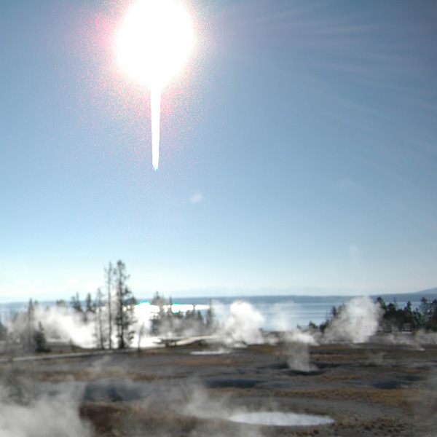
CMOS
CCD
BLOOMING EFFECT
Source: Wikipedia.org/Blooming
Notes:
Blooming

Slide 14
CMOS
CCD
BLOOMING EFFECT
Source: Wikipedia.org/Blooming
Notes:
Blooming. Otro aspecto en el que los sensores CMOS son superiores a los CCD es en el blooming. Este fenómeno se produce cuando un píxel se satura por la luz que incide sobre él y a continuación empieza a saturar a los que están a su alrededor. Aunque este defecto puede subsanarse gracias a algunos trucos en la construcción, en el caso de los CMOS nos olvidamos del problema.
Partido de Beisbol

Slide 15


CMOS
CCD
Notes:
he rolling shutter occurs because the sensor scans fast across the scene instead of exposing it all at once. Due to this, with the vibrating or fast moving subjects, you get the weird shapes in the video, since the subjects move faster than they’re captured.
In high end CMOS, this is fixed.
La respuesta uniforme es el resultado que se espera de un píxel sometido al mismo nivel de excitación que los demás, y que éste no presente cambios apreciables en la señal obtenida. En este aspecto, el que un sensor CMOS esté constituido por píxeles individuales, le hace más propenso a sufrir fallos. En el CCD, al ser toda la matriz de píxeles uniforme, tiene un mejor comportamiento. A pesar de todo, la adición de circuitos con realimentación nos permite subsanar este problema en los CMOS, los CCD están un poquito por encima igualmente.

Slide 16
FUTURE DEVELOPMENT
CMOS
CCD
FUTURE DEVELOPMENT
Faster readout
Higher resolutions
Extreme Dynamic range
Time delay and integration
No future development expected
Notes:
Entonces, ¿por qué si los sensores CMOS tienen menor calidad de imagen se están empezando a implantar en las réflex? En realidad no tienen peor calidad de imagen. En sus inicios eran algo peores que los CCD, pero hoy día es un mal que está prácticamente subsanado. La tecnología CCD ha llegado a su límite y es ahora cuando se está desarrollando la CMOS
Fue por ello por lo que el CMOS empezó a implementarse en las cámaras de gama baja compactas, donde la baja calidad no era un gran problema. Ha sido tras la evolución de la tecnología cuando se ha empezado a implementar en cámaras réflex.
Cmos.Esto incluye una mejor sensibilidad, bajo consumo de energía, menos calor, y una mayor integración, con potencial para una mayor resolución, rango dinámico ampliado, y velocidades de cuadro más altas en el futuro.

Slide 17
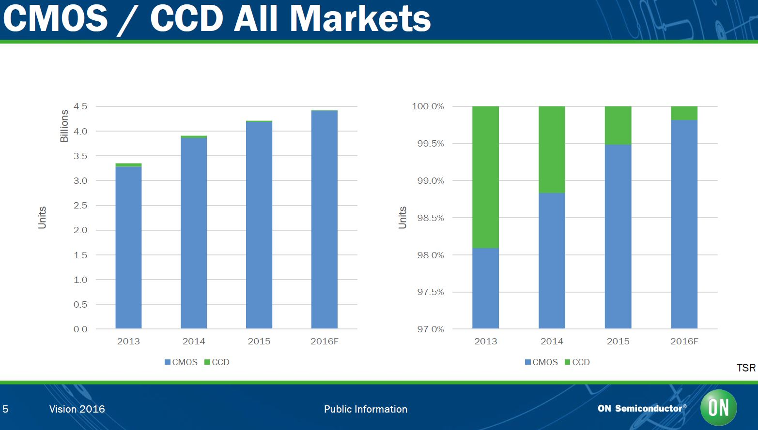
Source: ON Semiconductors

Slide 18
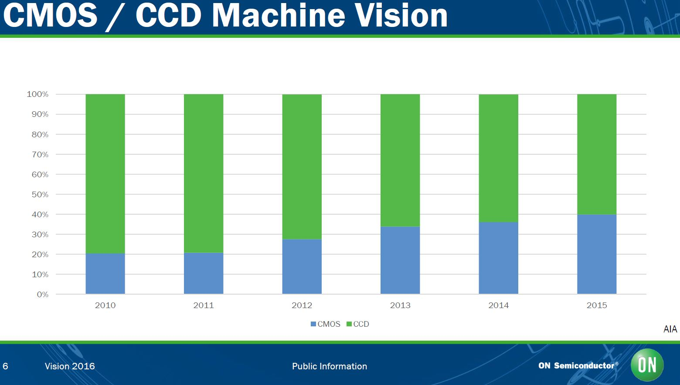
Source: ON Semiconductors

Slide 19
Which sensor is better for camera?
CMOS
CCD
Digital cameras
Mobile Phones
Tablets
DSLR Cameras
Film productions
Broadcast TV
Notes:
CCD sensors are used in DSLR cameras. On the other hand, due to its longer battery life and lower cost, CMOS sensors are widely used in digital cameras, mobile phones, tablets, etc.
Broadcast professionals are very familiar with CCD technology. It has been used successfully in broadcast cameras for many years. But today, CMOS technology is taking hold in broadcast

Slide 20
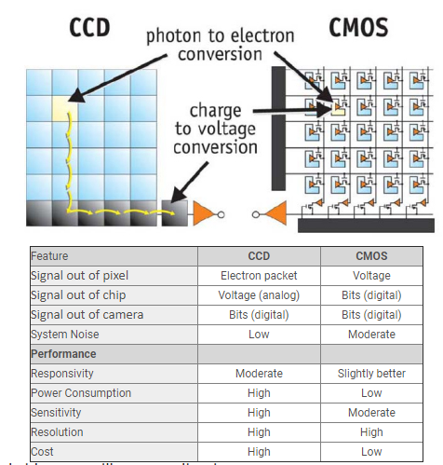
Source: Unifore.net

